Slide 1
Customer Satisfaction Using CoreQ

Slide 2
Families & Residents Highly Satisfied With Quality Of Care
Assisted Living
Skilled Nursing
According to CoreQ, nearly 80 percent of assisted living residents and their families are satisfied with their care.
According to CoreQ, nearly 70 percent of skilled nursing residents and their families are satisfied with their care.

Slide 3
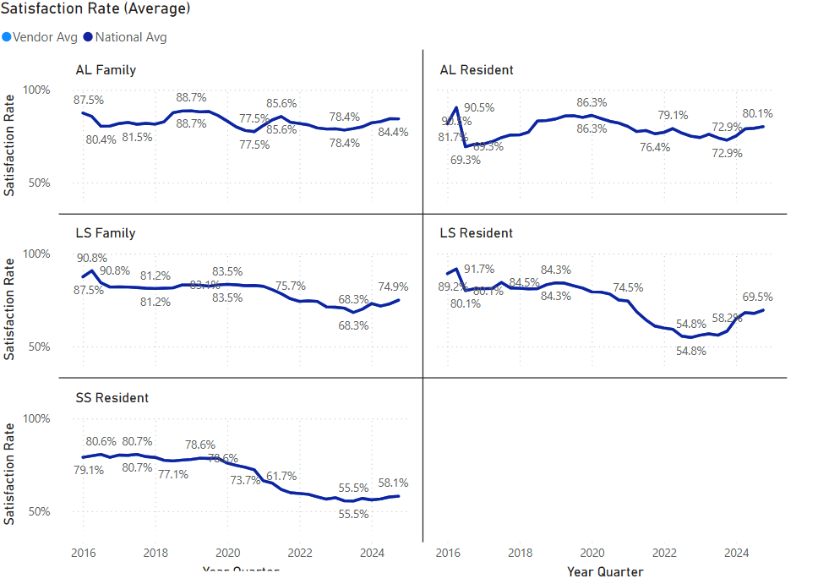
CoreQ Rates by Measure

Slide 4
Background
Nick Castle, Ph.D., led an effort with input from an AHCA/NCAL workgroup to develop a short, reliable and valid questionnaire that could be added to existing survey instruments or used by itself to collect information to calculate a set of quality measure(s) related to individuals discharged following short-term rehabilitation services, for long-stay resident and their family members and for residents and their families in assisted living.
The skilled nursing facility and assisted living related measures were endorsed by the CMS’s consensus-based entity in 2016 and 2018, respectively.

Slide 5
What is CoreQ?
CoreQ is a set of five measures for skilled nursing facilities (SNF) and assisted living (AL) communities to use to assess satisfaction among patients, residents, and their families.
  Based on a core set of customer satisfaction questions, CoreQ measures allow consistent measurement across long term and post-acute care settings.
All five measures are endorsed by the Partnership for Quality Measurement, a Centers for Medicare & Medicaid Services (CMS) certified consensus-based entity.
All measures have been independently tested as valid and reliable measures of customer satisfaction.

Slide 6

CoreQ Measures
Skilled Nursing Facility Measures
Assisted Living Measures
Measure #1: Short-Stay Discharges Satisfaction defined as the percentage of individuals discharged from short-term rehab.
Measure #2: Long-Stay Resident Satisfaction defined as the percentage of individuals who are long-stay residents who were satisfied.
Measure #3: Long-Stay Family Satisfaction defined as the percentage of families or designated responsible party for long-stay residents who were satisfied.
Measure #4: Assisted Living Resident Satisfaction defined as the percentage of AL residents or designated responsible party who were satisfied.
Measure #5: Assisted Living Family Satisfaction defined as the percentage of families or designated responsible party for AL residents who were satisfied.

Slide 7
How is CoreQ Calculated?
The CoreQ questionnaires use a 5-point Likert Scale: Poor (1), Average (2), Good (3), Very Good (4), Excellent (5).
It can be administered as a stand-alone questionnaire or included in a longer questionnaire.
It is recommended that CoreQ appear first, when used as part of a longer satisfaction questionnaire.
It is important that CoreQ be administered in the order listed, with the exact wording of the questions and scale.

Slide 8
Benefits of Using CoreQ
Maintain and gain referral partners, such as hospitals and managed care organizations.
Share data with consumers and families to demonstrate commitment to quality.
Identify areas for operational improvement.
Benchmark metrics to peers and trend performance in LTC Trend Tracker.
Apply to the AHCA/NCAL National Quality Award Program.
Achieve organizational excellence and understand resident preferences.
Help residents and families choose and trust a health care facility.
Some facilities receive higher reimbursement rates or funding increases based on results through incentive payment programs such as the Value-Based Purchasing Program and the Quality Reporting Program.

Slide 9
Testimonial from an AHCA/NCAL National Quality Award Recipient
“The quality award program has been beneficial to our facility because it has kept us on a path of continuous improvement. By teaching us to constantly examine and improve our processes, this journey has allowed us to make meaningful changes that have positively impacted our residents, employees and other stakeholders.”- Magnolia Manor of Marion County, Buena Vista, Georgia.
During the 2020 Coronavirus pandemic the facility saw the need to continue measuring satisfaction to keep quality at the forefront and to ensure that residents were satisfied with their care, Magnolia Manor of Marion County achieved 100% resident satisfaction using the CoreQ resident surveys.

Slide 10
More Information
If you have questions related to CoreQ, please email CoreQ@ahca.org.
More information is located in the CoreQ Technical Manual.

